Slide 2
Session 2:
Evaluation Criteria & Proposal application form
Proposal Writing Camp

Slide 3
1. Evaluation process, criteria and scores

Slide 4



Standard evaluation criteria
There are three evaluation criteria for full proposals:
The criteria are adapted to each type of action, as specified in the Work Programme
An exception is the ERC, which uses a different set of criteria.
Quality and efficiency of implementation
Excellence
Impact

Slide 5

Overview of the evaluation process
Evaluators
(min.3
For each
proposal)
Commission
Commission
Receipt of Proposals
Individual Evaluation
Consensus Group
Panel
Review
Finalisation
Eligibility check
Allocation
of proposals
to evaluators
Individual Evaluation Reports
(Usually done remotely)
Consensus Report
(May be done remotely)
Panel Report
Evaluation Summary Report
Panel ranked list
Final ranked list
Notes:
Comment for Trainer on process:
1) Eligible to undergo the evalutation
2) The evaluation process has three phases
Phase 1 – Individual evaluation: Experts evaluate proposals individually, giving a score for each evaluation criteria with explanatory comments (each full proposal is evaluated by at least three experts)
Phase 2 – Consensus group: All experts who have evaluated the same proposals meet in a consensus group to agree on a common position, including comments and scores (each consensus group is assisted by a moderator who is in general a Commission official)
Phase 3 – Panel review: The panel recommends a priority

Slide 6
Admissibility and eligibility checks
Admissibility, Eligibility & Scope check
Admissibility is checked by the Agency:
  Readable, accessible and printable
  Completeness of proposal
  presence of all requested forms
  Plan for exploitation and dissemination of results
  (unless otherwise specified in the WP)
Eligibility checked by the Agency
  Minimum number of partners as set out in the call conditions
  Other criteria may apply on a call-by-call basis as set out in the call conditions
“Out of scope” – you need to check the scope of proposals
  A proposal will only be deemed ineligible in clear-cut cases
Page limits: Clearly set out in electronic system; excess page(s) marked with a watermark

Slide 7
Evaluation criteria
The evaluation criteria are adapted to each type of action, as specified in the WP. E.g. relevance of innovation.
Three broad evaluation criteria:
  Excellence (relevant to the topic of the call)
  Impact
  Quality and efficiency of the implementation
Innovation Management: is a process which requires an understanding of both market and technical problems, with a goal of successfully implementing appropriate creative ideas.
Typical Output: new or improved product, service or process.
For consortium: it allows to respond to an external or internal opportunity.

Slide 8
Evaluation criteria
Excellence
Clarity and pertinence of the project’s objectives, and the extent to which the proposed work is ambitious, and goes beyond the state of the art.
Soundness of the proposed methodology, including the underlying concepts, models, assumptions, interdisciplinary approaches, appropriate consideration of the gender dimension in research and innovation content, and the quality of open science practices, including sharing and management of research outputs and engagement of citizens, civil society and end users where appropriate.

Slide 9
Evaluation criteria
Impact
Credibility of the pathways to achieve the expected outcomes and impacts specified in the work programme, and the likely scale and significance of the contributions due to the project.
Suitability and quality of the measures to maximise expected outcomes and impacts, as set out in the dissemination and exploitation plan, including communication activities.

Slide 10
Evaluation criteria
Quality and efficiency of the implementation
Quality and effectiveness of the work plan, assessment of risks, and appropriateness of the effort assigned to work packages, and the resources overall
Capacity and role of each participant, and extent to which the consortium as a whole brings together the necessary expertise.

Slide 11
What else you need to know about the evaluation process
The European Commission organises the evaluation and moderates the process
Independent observers check the functioning and running of the overall process and advise, in their report, on the conduct and fairness of the evaluation sessions and, if necessary, suggest possible improvements
An ethics review takes place for proposals above threshold and considered for funding. Only proposals that comply with the ethical principles and legislation may receive funding

Slide 12
Evaluation scores
The maximum overall score is 15 (3x5), unless a weighting is applied
Generally a pre-defined qualifying score on each criterion and an overall qualifying score needs to be achieved.
  Standard practice (thresholds)
  Excellence
  3
  +
  Impact
  3
  +
  Implementation
  3
  =
  10
Qualifying scores may vary
    according to type of action
    between the first and second stage proposals in two-stage procedures
Notes:
For the Trainer:
To be considered for funding a proposal must achieve a pre-defined qualifying score on each criterion, and an overall qualifying score. Qualifying scores vary according to the type of action – and between the first and second stage proposals in the case of two-stage procedures.

Slide 13

Evaluation scores
0:Proposal fails to address the criterion or cannot be assessed due to missing or incomplete information
    1:Poor – criterion is inadequately addressed or there are serious inherent weaknesses
    2:Fair – proposal broadly addresses the criterion, but there are significant weaknesses
    3:Good – proposal addresses the criterion well, but a number of shortcomings are present
    4:Very good – proposal addresses the criterion very well, but a small number of shortcomings are present
    5: Excellent – proposal successfully addresses all relevant aspects of the criterion. Any shortcomings are minor
Experts score each award criterion on a scale from 0 to 5 (half point scores may be given):

Slide 14
Evaluation – new elements in Horizon Europe
Pilot on „Blind evaluation“ in first HE two-stage calls: anonymised short proposals in 1st stage
Pilot on ‘Right to react’ (rebuttal): more transparency and more detailed feedback option
Portfolio-based calls (e.g. Missions, EIC pathfinder): portfolio considerations

Slide 15
Where to find the full information?
https://ec.europa.eu/info/research-and-innovation/funding/funding-opportunities/funding-programmes-and-open-calls/horizon-europe_en

Slide 16
2. Evaluation Summary Report
Exercise

Slide 17
Exercise: Evaluation Summary report H2020
Analysis of an extract of an Evaluation Summary Report (ESR)
Read an extract from an ESR, call 2021 on Wind energy – Challenge 5; ESR report received in May 2022
We take Criterion 3 - Quality and efficiency of the implementation (criterion 1 excellence and criterion 2 impact not discussed in this example)
Review of implementation (work-packages, tasks, management, budget items)
When you read the comments of evaluators, how would you score the project on implementation, on a scoring range 0-5?
Text will be displayed & handed out in paper copy
At the end of exercise the original will be displayed with score for this criterion: are the score and comments justified/ok, or too high, or too low?
Notes:
Hand out the evaluation text in paper copy. PWC participants read the evaluation, discuss in small group, and give score. Discuss and provide feedback.

Slide 18
Example: Evaluation Summary report
Criterion 3 - Quality and efficiency of the implementation
The following aspects will be taken into account:
Quality and effectiveness of the work plan, assessment of risks, and appropriateness of the effort assigned to work packages, and the resources overall
Capacity and role of each participant, and extent to which the consortium as a whole brings together the necessary expertise.

Slide 19
Example: Evaluation Summary report
Criterion 3 - Quality and efficiency of the implementation
Overall, the proposal addresses the criterion well. In particular:
* In general, the work plan is effective and of acceptable quality. For example, the breakdown of the project into appropriate work packages and their tasks is convincing, and proportionate to the scale and complexity of the proposed project.
* Milestones are sufficient in number, and timing, and their means of verification. They are appropriate to enable effective monitoring of project progress.
* The content of the deliverables is appropriate to document the outputs of the project.
* The resources assigned to work packages are credibly in line with their objectives and deliverables.
* Each participant has a specific and valid role, and the capacity to carry it out.
* The consortium as a whole brings together the necessary expertise, including valuable previous experience with Local Water Forums, and previous involvement in a
range of H2020 projects.

Slide 20
Example: Evaluation Summary report
Criterion 3 - Quality and efficiency of the implementation
Nevertheless, a number of shortcomings are present, namely:
* Some of the initial deliverables are not scheduled early enough for effective project progress. For example, deliverables on quality control and risk management, and data management, are not scheduled until month 6, and the launch of the website is not scheduled until month 4, which is not sufficiently justified.
* The proposal does not sufficiently identify critical risks concerning the access and availability of testing grounds; and does not credibly mitigate potential difficulties in setting up the local sustainable energy assemblies (e.g. lack of trust and acceptance in the local communities) beyond one-way communication.
* The proposal does not provide sufficient justification for the purchase costs allocated to partner 11 (€53,100, which is 27.7% of Personnel costs) or to partner 13 (€85,500, which is 48.8% of Personnel Costs).

Slide 21
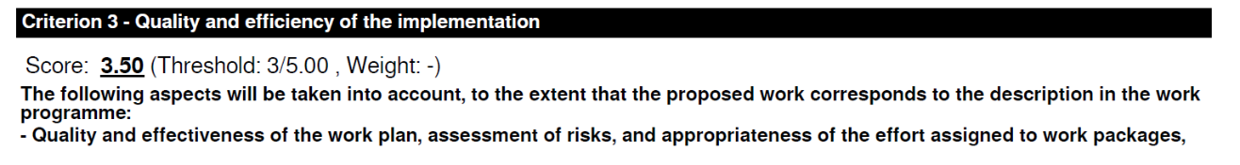
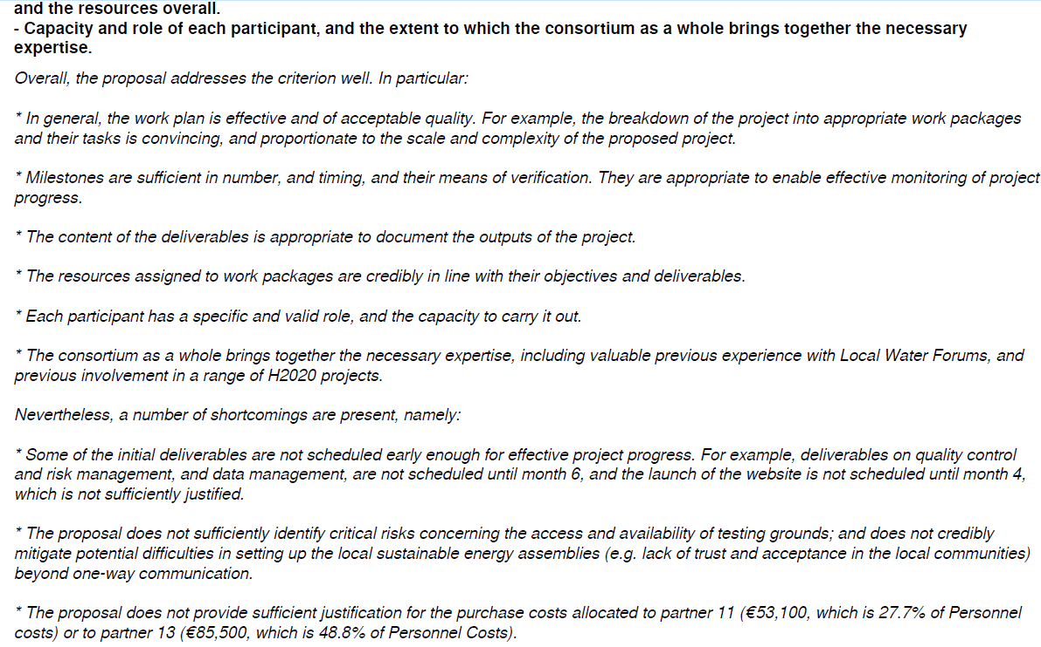
Notes:
Proposal was not funded. First shortcoming seems a bit bureaucratic assessment; website in M4 is not unusual. Third shortcoming is a pity that proposers have forgotten it; don‘t forget these budget justifications if they are required.

Slide 22
3. Exercise: Proposal application form

Slide 23
Example: structure of a HORIZON EUROPE - RIA (Research & Innovation Action)
Standard Horizon Europe application form RIA/IA: https://ec.europa.eu/info/funding-tenders/opportunities/docs/2021-2027/horizon/temp-form/af/af_he-ria-ia_en.pdf
Part A (online form)
Administrative forms
Part B
(to be uploaded as pdf PDF)
Excellence
Impact
Quality and efficiency of implementation
->additional Annex with information on financial support to third parties (if applicable)
Notes:
Link to standard application form included: possibly copy in chat, so that all participants can download it immediately during the PWC.

Slide 24
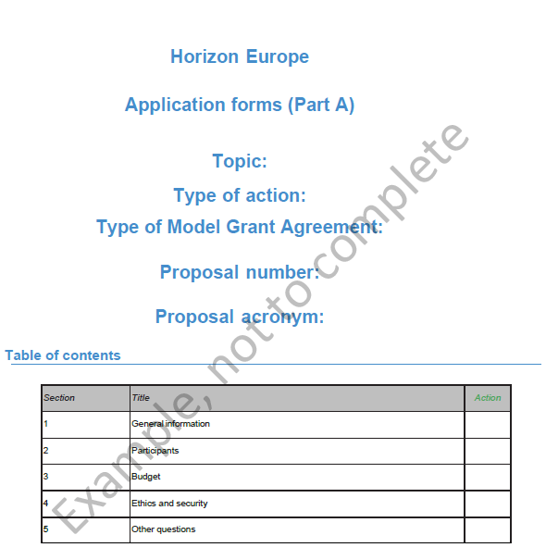
Part A (online forms)
Administrative forms
to be completed online (Funding and tender portal)

Slide 25
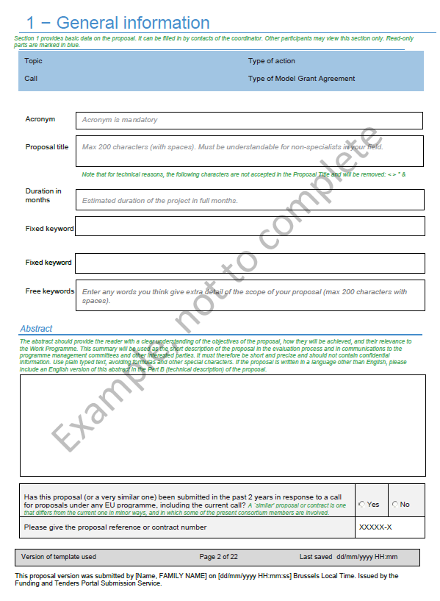

Slide 26
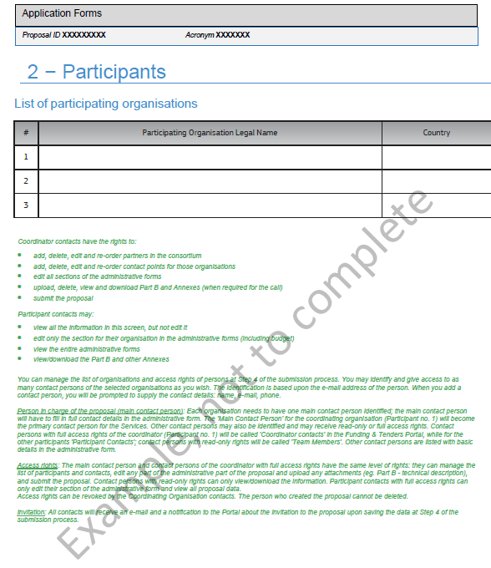

Slide 27
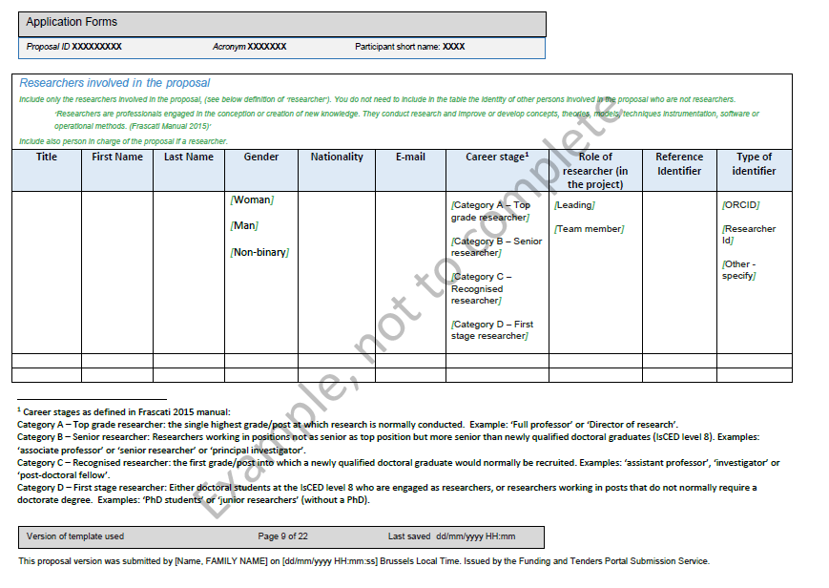

Slide 28
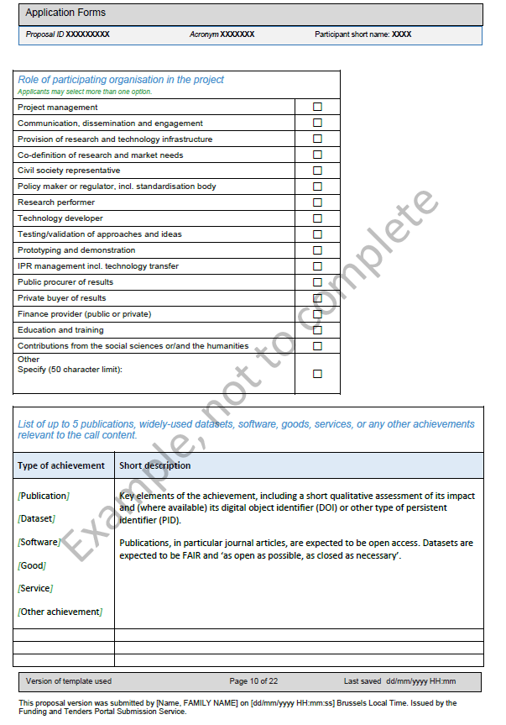

Slide 29
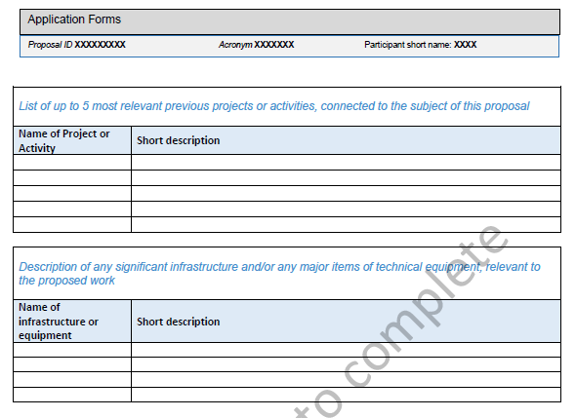

Slide 30
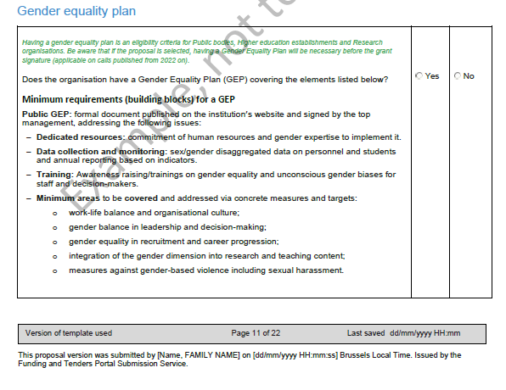

Slide 31
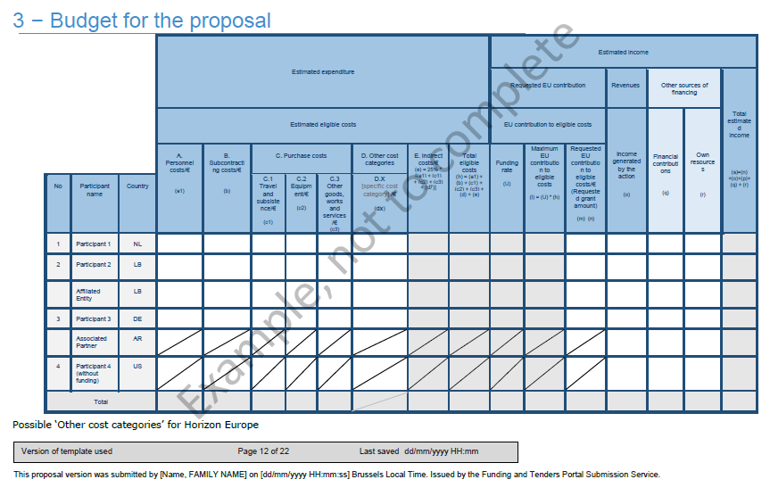

Slide 32
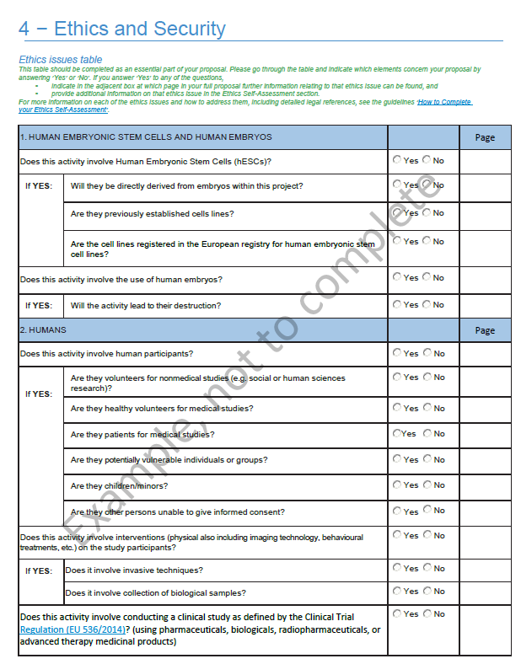
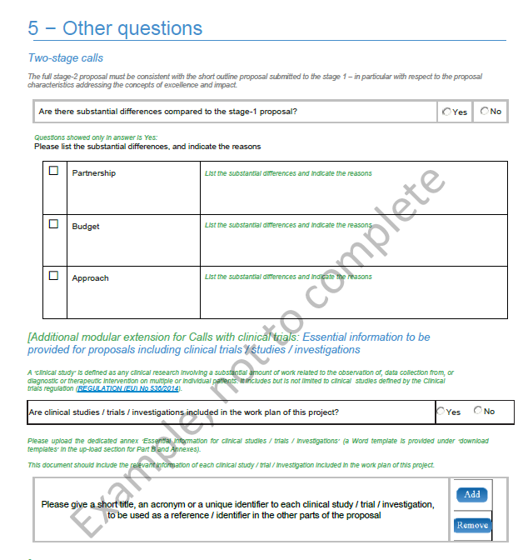

Slide 33
Example: structure of a HORIZON EUROPE - RIA (Research & Innovation Action)
Part B
(to be uploaded as pdf PDF)
Excellence
Impact
Quality and efficiency of implementation
->additional Annex with information on financial support to third parties (if applicable)

Slide 34
STRUCTURE OF PART B (RIA)B
1. Excellence
1.1 Objectives and ambition
1.2 Methodology
2. Impact
2.1 Project´s pathways to impact
2.2 Measures to maximise impact Dissemination
Exploitation and Communication
2.3 Summary
3. Quality and efficiency of the implementation
3.1 Work plan and Resources
3.2 Capacity of participants and consortium as a whole
PAGE LIMIT! 45 pages (RIA) /
50 pages for topics using lump sum funding
(including title page and list of participants)

Slide 35
Contact us!
Trainer 1
Trainer 2
eu-eap_sticooperation@servicefacility.eu

Slide 36
Thank you!
#HorizonEU
http://ec.europa.eu/horizon-europe

